Slide 1
Azure Well-Architected Framework review - Azure Kubernetes Service (AKS)
Notes:
These Learn modules are part of the AZ-204: Implement Azure App Service web apps (https://learn.microsoft.com/training/paths/create-azure-app-service-web-apps/) learning path.

Slide 2
Agenda
Five pillars of architecture excellence
Baseline architecture for AKS cluster
Azure Kubernetes Service cost analysis
Azure Well Architected Framework
Azure Kubernetes Service (AKS) - operations

Slide 3
Five pillars of architecture excellence
Notes:
https://learn.microsoft.com/training/modules/introduction-to-azure-app-service/

Slide 4
Reliability
Security
Cost optimization
Operational excellence
Performance efficiency

Slide 5
Baseline architecture for an Azure Kubernetes Service (AKS) cluster
Notes:
This architecture isn't focused on a workload, rather it concentrates on the AKS cluster itself. The information here is the minimum recommended baseline for most AKS clusters. It integrates with Azure services that deliver observability, a network topology that supports multi-regional growth, and secures the in-cluster traffic.
The target architecture is influenced by your business requirements, and as a result it can vary between different application contexts. It should be considered as your starting point for pre-production and production stages.

Slide 6
Networking configuration
Network topology
Plan the IP addresses
Deploy Ingress resources
Cluster compute
Compute for the base cluster
Container image reference
Policy management
Identity management
Integrate Microsoft Entra ID for the cluster
Managed Identity
Secure data flow
Secure the network flow
Add secret management
Business continuity
Operations
Scalability
Cluster and node availability
Availability and multi-region support
Cluster and workload CI/CD pipelines
Cluster health and metrics
Cost management and reporting

Slide 7
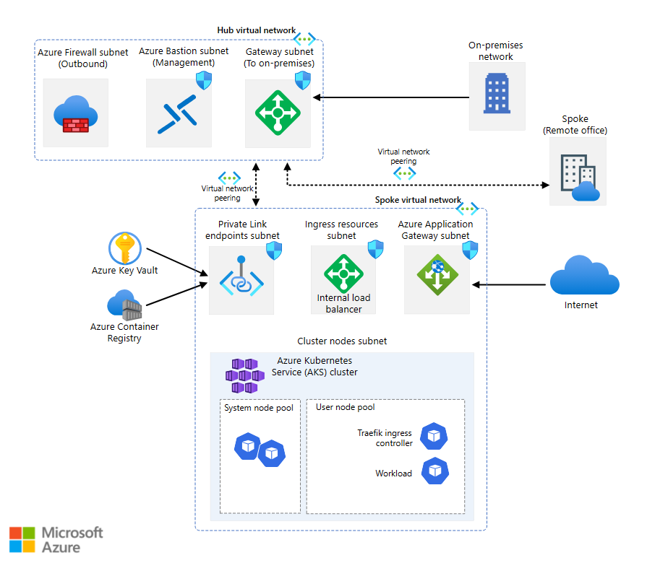
https://github.com/mspnp/aks-baseline

Slide 8
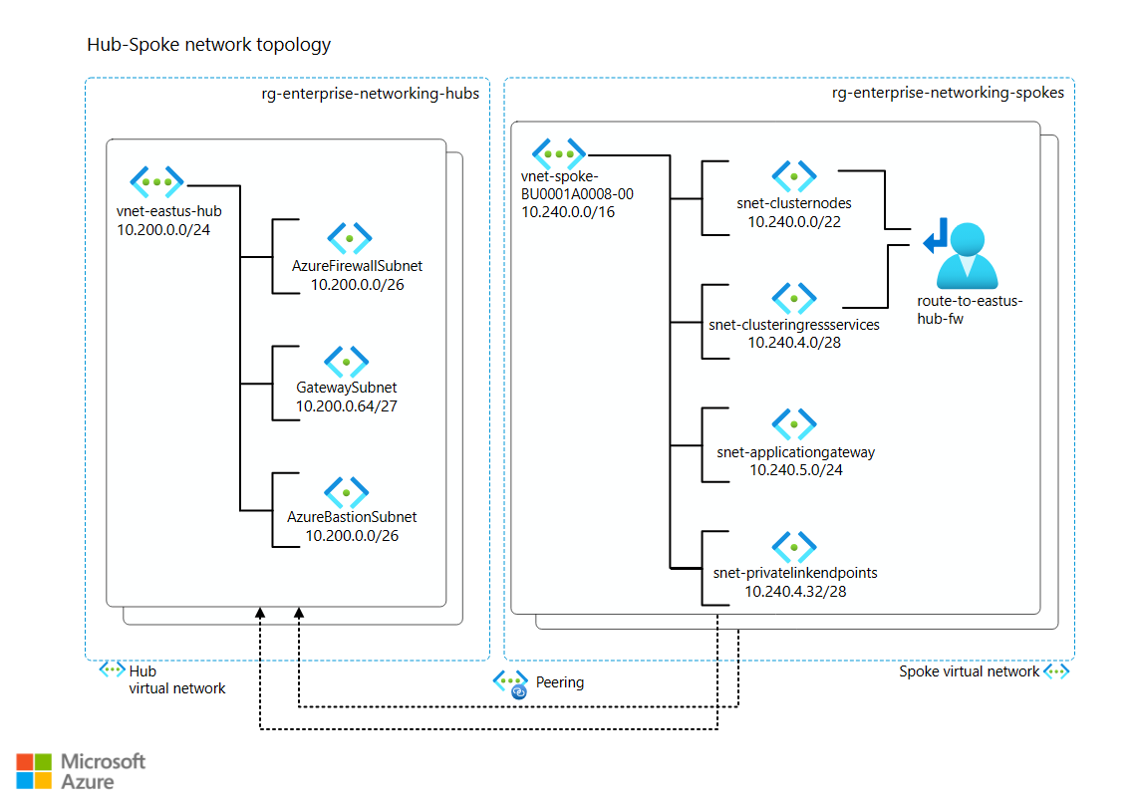
Plan the IP addresses

Slide 9
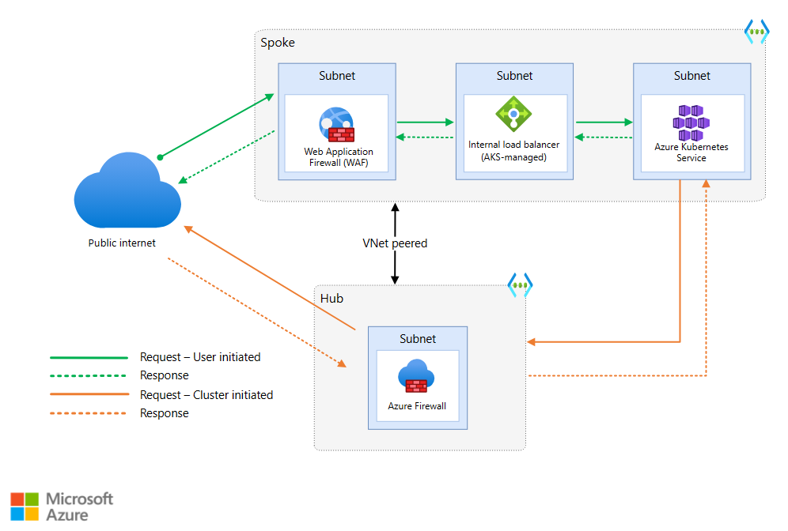
Secure the network flow
Notes:
Network flow, in this context, can be categorized as:
Ingress traffic. From the client to the workload running in the cluster.
Egress traffic. From a pod or node in the cluster to an external service.
Pod-to-pod traffic. Communication between pods. This traffic includes communication between the ingress controller and the workload. Also, if your workload is composed of multiple applications deployed to the cluster, communication between those applications would fall into this category.
Management traffic. Traffic that goes between the client and the Kubernetes API server.

Slide 10
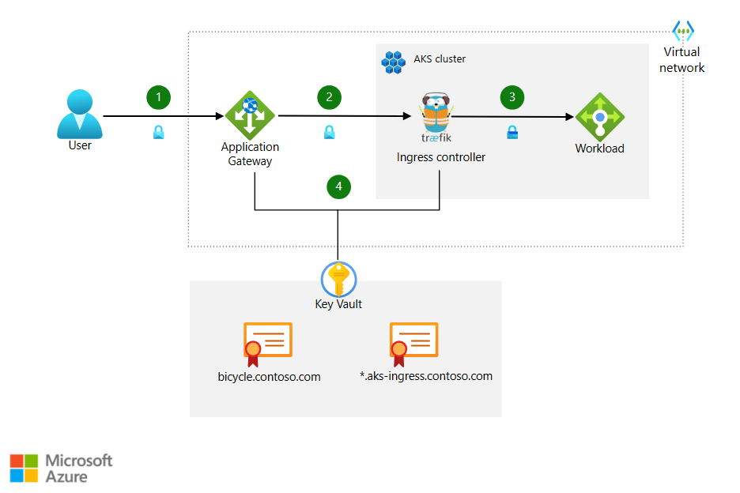
Ingress traffic flow
Notes:
The client sends an HTTPS request to the domain name: bicycle.contoso.com. That name is associated with through a DNS A record to the public IP address of Azure Application Gateway. This traffic is encrypted to make sure that the traffic between the client browser and gateway cannot be inspected or changed.
Application Gateway has an integrated web application firewall (WAF) and negotiates the TLS handshake for bicycle.contoso.com, allowing only secure ciphers. Application Gateway is a TLS termination point, as it's required to process WAF inspection rules, and execute routing rules that forward the traffic to the configured backend. The TLS certificate is stored in Azure Key Vault. It's accessed using a user-assigned managed identity integrated with Application Gateway. For information about that feature, see TLS termination with Key Vault certificates.
As traffic moves from Application Gateway to the backend, it's encrypted again with another TLS certificate (wildcard for *.aks-ingress.contoso.com) as it's forwarded to the internal load balancer. This re-encryption makes sure traffic that is not secure doesn't flow into the cluster subnet.
The ingress controller receives the encrypted traffic through the load balancer. The controller is another TLS termination point for *.aks-ingress.contoso.com and forwards the traffic to the workload pods over HTTP. The certificates are stored in Azure Key Vault and mounted into the cluster using the Container Storage Interface (CSI) driver. For more information, see Add secret management.
You can implement end-to-end TLS traffic all at every hop the way through to the workload pod. Be sure to measure the performance, latency, and operational impact when making the decision to secure pod-to-pod traffic. For most single-tenant clusters, with proper control plane RBAC and mature Software Development Lifecycle practices, it's sufficient to TLS encrypt up to the ingress controller and protect with Web Application Firewall (WAF). That will minimize overhead in workload management and network performance impacts. Your workload and compliance requirements will dictate where you perform TLS termination.

Slide 11
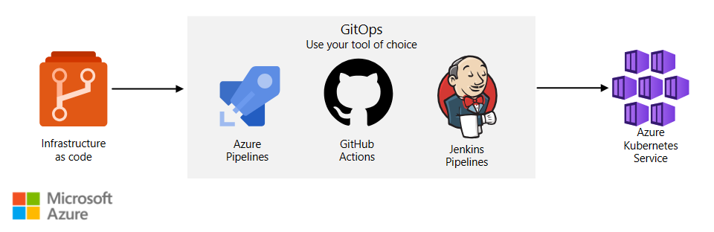
Cluster CI/CD

Slide 12
Azure Kubernetes Service cost analysis
Notes:
This architecture isn't focused on a workload, rather it concentrates on the AKS cluster itself. The information here is the minimum recommended baseline for most AKS clusters. It integrates with Azure services that deliver observability, a network topology that supports multi-regional growth, and secures the in-cluster traffic.
The target architecture is influenced by your business requirements, and as a result it can vary between different application contexts. It should be considered as your starting point for pre-production and production stages.

Slide 13
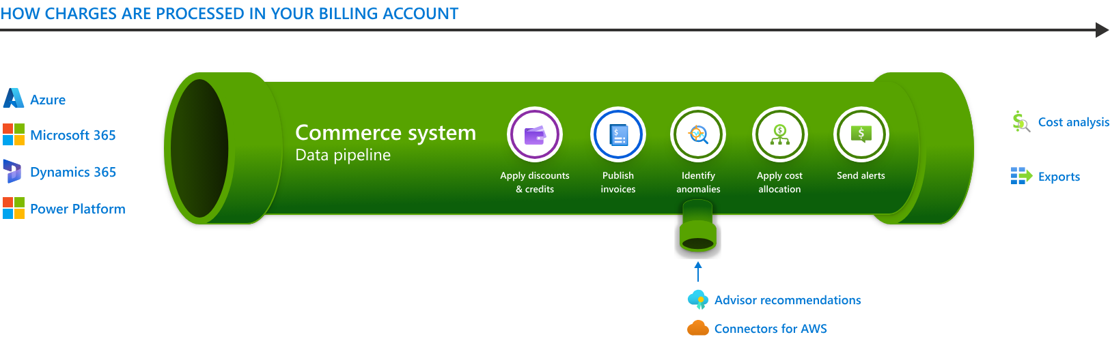
Microsoft Cost Management (MCM)
Notes:
After discounts are applied, cost details then flow into Cost Management, where:
The anomaly detection model identifies anomalies daily based on normalized usage (not rated usage).
The cost allocation engine applies tag inheritance and splits shared costs.
AWS cost and usage reports are pulled based on any connectors for AWS you may have configured

Slide 14
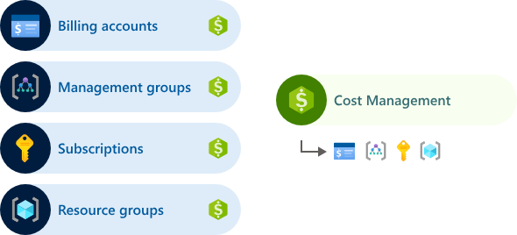
How Cost Management and Billing relate
Cost Management is a set of FinOps tools that enable you to analyze, manage, and optimize your costs.
Billing provides all the tools you need to manage your billing account and pay invoices.

Slide 15
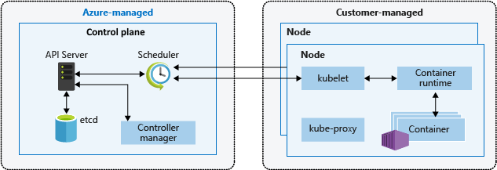
AKS cost basics
Kubernetes architecture comprises two layers: control plane and nodes/ node pools.
AKS pricing model aligns with these layers.
Control plane includes core Kubernetes services like API server and etcd, as well as workload orchestration.
Azure platform manages AKS control plane, with no cost in the free tier.
Nodes, also known as agent nodes or worker nodes, host Kubernetes workloads.
Customers fully manage and pay for all costs associated with agent nodes in AKS

Slide 16
https://azure.microsoft.com/en-in /pricing/details/kubernetes-service/
https://azure.microsoft.com/en-in/pricing/calculator/?service=kubernetes-service

Slide 17
Cost Consideration for Nodes
AKS nodes utilize various Azure infrastructure resources including virtual machine scale sets, virtual networks, and managed disks.
Most Azure virtual machine (VM) types can be directly used within AKS.
Significant discounts on compute resources can be obtained using Azure Reservations and Azure Spot Instance.
AKS cluster pricing is determined by the class, number, and size of VMs in the node pools.
VM cost factors include size, CPU type, vCPUs, memory, family, and storage type (e.g., high-performance SSD or standard HDD).
Node size planning should consider application requirements, number of nodes, and cluster scalability needs.

Slide 18
Cost Consideration for Network
Azure Load Balancer:
Charges based on configured load-balancing and outbound rules.
Data processed inbound and outbound incurs charges.
No hourly charge for Standard Load Balancer with no rules configured.
Azure Application Gateway:
Charges include a fixed price set by hour or partial hour.
Capacity unit price adds consumption-based cost.
Public IP addresses
Public IP have associated costs

Slide 19
Cost Optimization
Check Azure Well-Architected Framework for AKS Cost optimization.
Use Azure Reservations for VMs for 1- or 3-year cost savings.
Add spot node pools for significant cost savings.
Set maximum price and enable cluster autoscaler for spot node pools.

Slide 20
Azure Well Architected Framework
Notes:
This architecture isn't focused on a workload, rather it concentrates on the AKS cluster itself. The information here is the minimum recommended baseline for most AKS clusters. It integrates with Azure services that deliver observability, a network topology that supports multi-regional growth, and secures the in-cluster traffic.
The target architecture is influenced by your business requirements, and as a result it can vary between different application contexts. It should be considered as your starting point for pre-production and production stages.

Slide 21
Operational Excellence
Implement Infrastructure as Code (IaC) for consistent cluster deployment.
Utilize Kubernetes-native tools like Helm for application management.
Establish clear governance policies and RBAC for access control.
Conduct regular health checks and performance tuning.
Implement logging, monitoring, and alerting solutions.

Slide 22
Operational Excellence: Design Checklist
Cluster Architecture:
Enable cluster autoscaler to adjust agent node count based on workload demands.
Utilize Horizontal Pod Autoscaler to adjust pod count based on CPU utilization or select metrics.
Cluster and Workload Architectures:
Perform detailed capacity planning exercises covering SKU, autoscale settings, IP addressing, and failover considerations.
Conduct ongoing load testing activities to test pod and cluster autoscaler performance.
Separate workloads into different node pools for independent scaling.

Slide 23
Security
Enforce network segmentation using Azure NSGs and Kubernetes Policies.
Implement encryption with Azure Key Vault and TLS.
Apply regular security patches and updates.
Use Azure Security Center and Policy for compliance.
Conduct security audits and penetration testing.

Slide 24
Security – Design Checklist
Cluster Architecture:
Utilize Managed Identities to avoid managing and rotating service principles.
Implement Kubernetes role-based access control (RBAC) with Microsoft Azure AD for least privilege access.
Utilize Microsoft Defender for containers with Azure Sentinel for threat detection and response.
Deploy private AKS clusters or utilize API server allow lists for network security.
Workload Architecture:
Implement a Web Application Firewall for securing HTTP(S) traffic.
Harden CI/CD pipelines with container-aware scanning.

Slide 25
Reliability
Design clusters across multiple availability zones.
Implement automated backups and disaster recovery plans.
Utilize Kubernetes features for service availability during maintenance.
Monitor health and performance with Azure Monitor.
Conduct chaos engineering experiments.

Slide 26
https://learn.microsoft.com/en-us/azure/aks/cis-kubernetes

Slide 27
Reliability- Design Checklist
Cluster Architecture:
For critical workloads, utilize availability zones for AKS clusters.
Plan IP address space for scalable clusters, including failover traffic handling in multi-cluster setups.
Enable Container Insights for cluster monitoring and configure reliability-alerting mechanisms.
Leverage AKS Uptime SLA to meet availability targets for production workloads.
Workload Architecture:
Design workloads to support horizontal scaling.
Ensure applications report readiness and health accurately.
Cluster and Workload Architectures:
Run workloads on user node pools and select appropriate SKU sizes.
Maintain a minimum of two nodes for user node pools and three nodes for the system node pool.

Slide 28
Performance Efficiency
Optimize container images and resource requests.
Implement HPA and cluster autoscaling.
Use AKS node pools with different VM sizes.
Monitor performance with Azure Monitor and Application Insights.
Utilize Kubernetes features for resource allocation.

Slide 29
Performance Efficiency- Design Checklist
Cluster Architecture:
Implement template-based deployment using Bicep, Terraform, or similar tools for repeatability and traceability.
Automate cluster bootstrap with necessary configurations and deployments, typically through GitOps.
Workload Architecture:
Employ repeatable and automated deployment processes within the software development lifecycle.
Design workloads to emit telemetry, including liveliness and readiness statuses.
Cluster and Workload Architectures:
Enable diagnostics settings to log control plane or core API server interactions.
Utilize Container insights for metrics, logs, and diagnostics collection to monitor cluster and workload performance.
Implement chaos engineering practices targeting Kubernetes to identify reliability issues.
Optimize workloads for efficient operation and deployment in containers.
Enforce cluster and workload governance using Azure Policy.

Slide 30
Cost Optimization
Purchase Azure Reserved Instances or Azure Spot VMs.
Right-size node pools based on workload.
Implement lifecycle management policies.
Monitor spending with Azure Cost Management.
Utilize Azure Advisor recommendations.

Slide 31
Cost Optimization: Checklist
Cluster Architecture:
Utilize appropriate VM SKUs per node pool and consider reserved instances for long-term capacity requirements.
Review performance metrics including CPU, memory, storage, and network for cost optimization opportunities.
Workload Architecture:
Choose appropriate managed disk tier and size based on workload requirements.
Implement autoscalers to scale in during periods of lower workload activity.

Slide 32
https://learn.microsoft.com/en-gb/assessments/azure-architecture-review/

Slide 33
Azure Kubernetes Service (AKS) - operations
Notes:
This architecture isn't focused on a workload, rather it concentrates on the AKS cluster itself. The information here is the minimum recommended baseline for most AKS clusters. It integrates with Azure services that deliver observability, a network topology that supports multi-regional growth, and secures the in-cluster traffic.
The target architecture is influenced by your business requirements, and as a result it can vary between different application contexts. It should be considered as your starting point for pre-production and production stages.

Slide 34
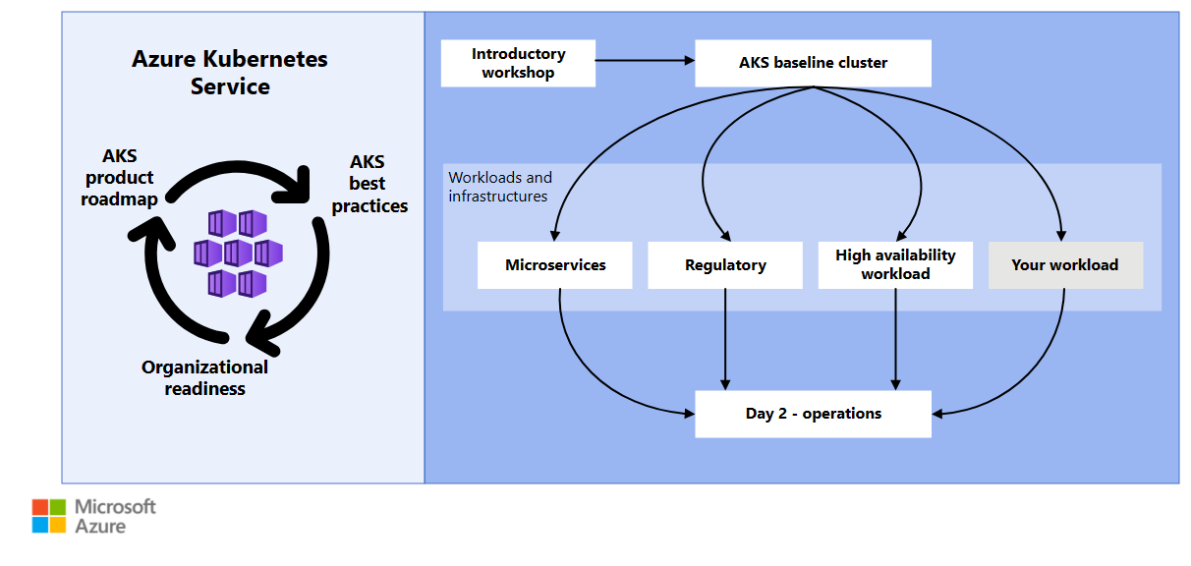

Slide 35
Step | Description
1. Evaluate AKS cluster health. | Check the overall health of the cluster and networking.
2. Examine node and pod health. | Evaluate the health of the AKS worker nodes.
3. Monitor workload deployments. | Ensure that all deployments and DaemonSet features are running.
4. Validate admission controllers. | Check whether the admission controllers are working as expected.
5. Verify the connection to the container registry. | Verify the connection to the container registry.

Slide 36
Evaluate AKS cluster health
Notes:
This architecture isn't focused on a workload, rather it concentrates on the AKS cluster itself. The information here is the minimum recommended baseline for most AKS clusters. It integrates with Azure services that deliver observability, a network topology that supports multi-regional growth, and secures the in-cluster traffic.
The target architecture is influenced by your business requirements, and as a result it can vary between different application contexts. It should be considered as your starting point for pre-production and production stages.

Slide 37
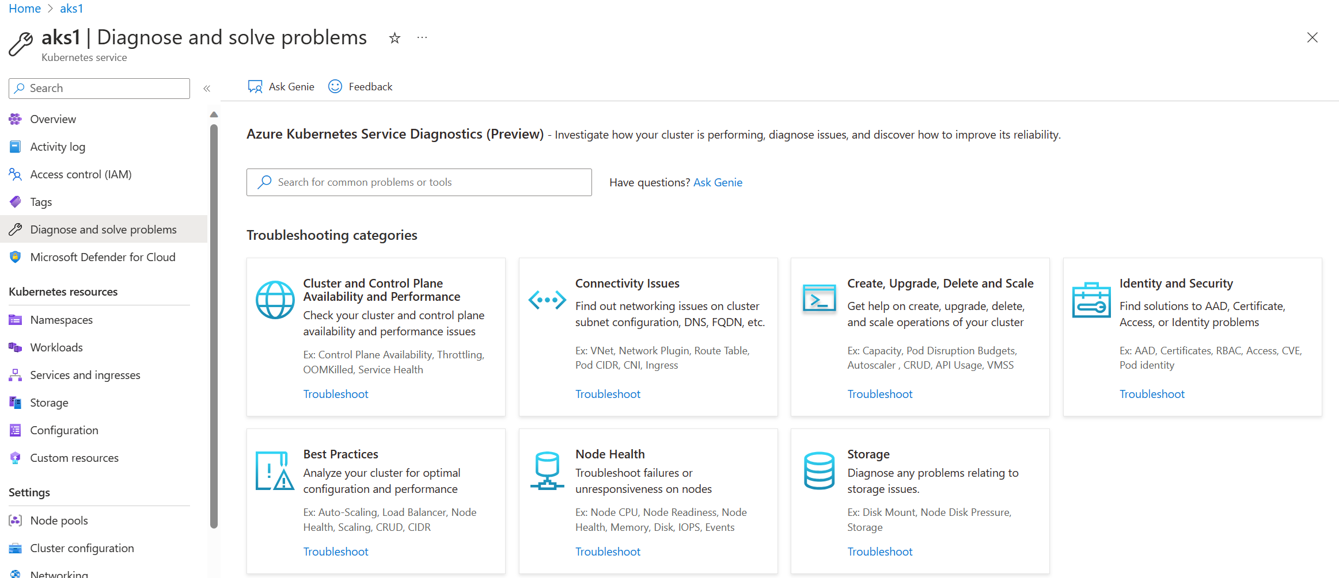
Diagnose and solve problems

Slide 38
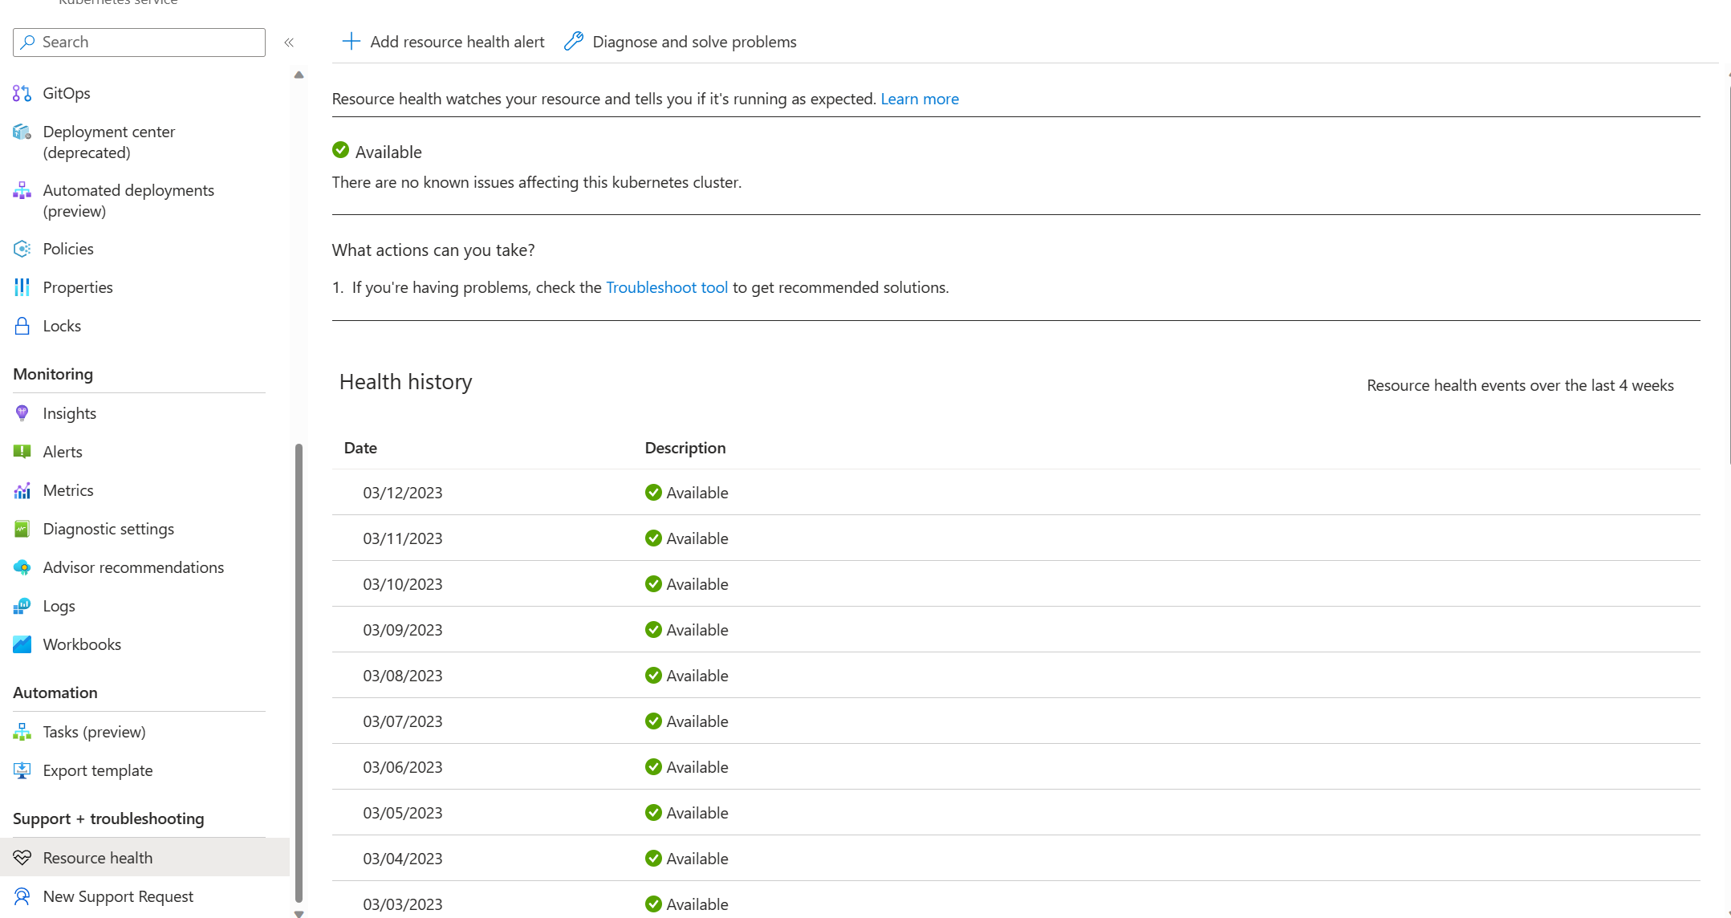
Resource Health

Slide 39
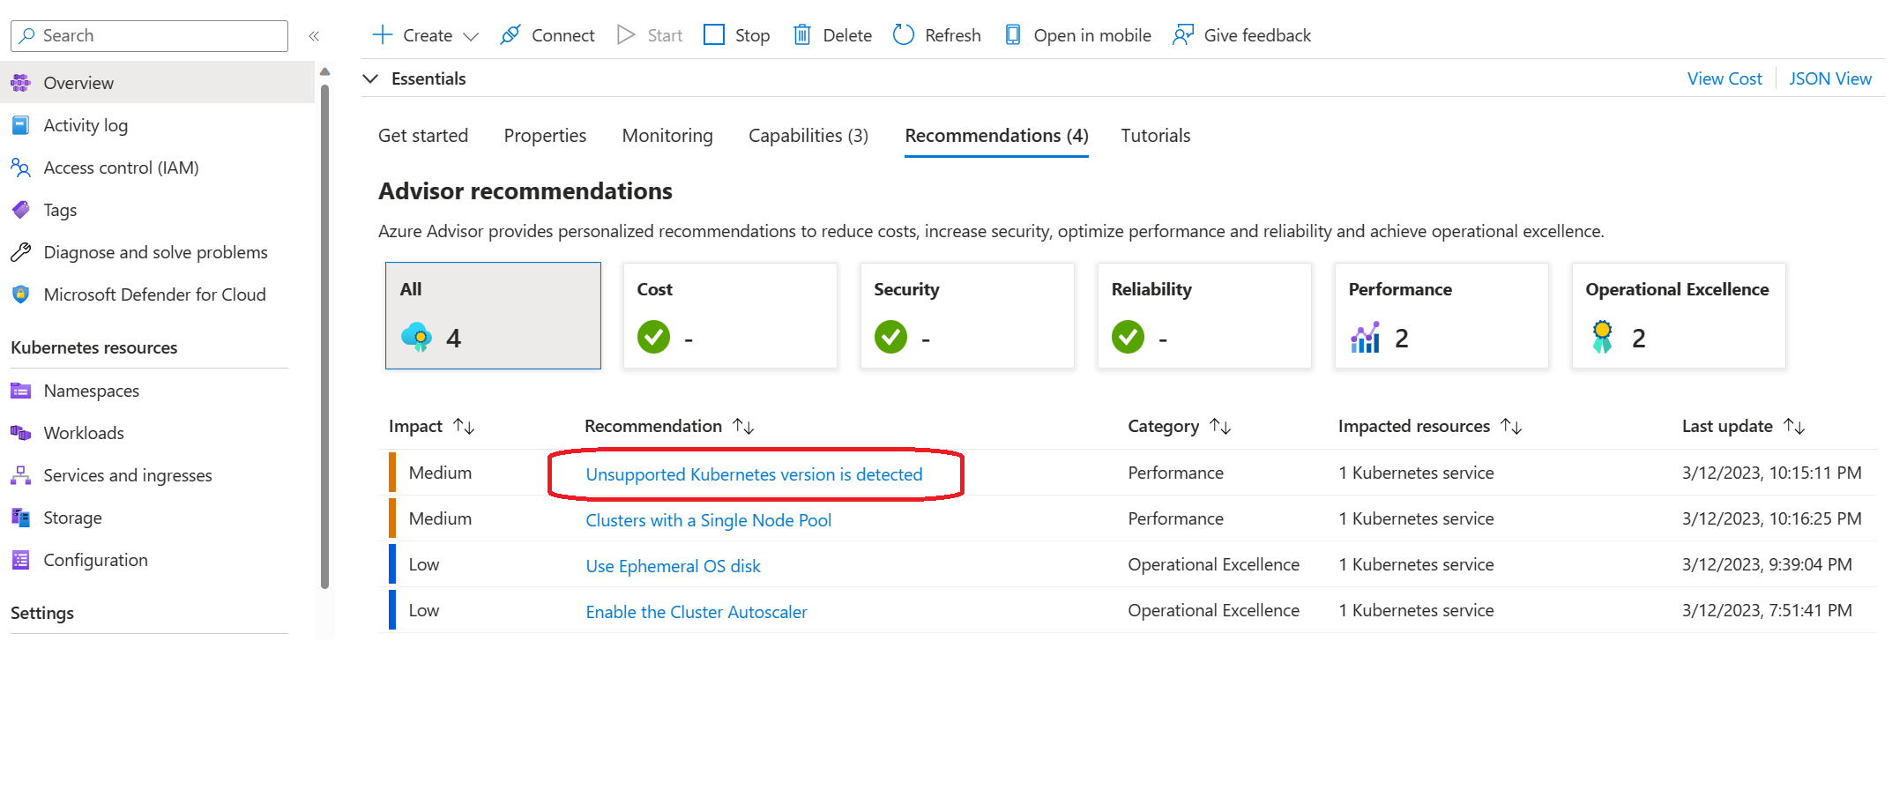
Advisor

Slide 40
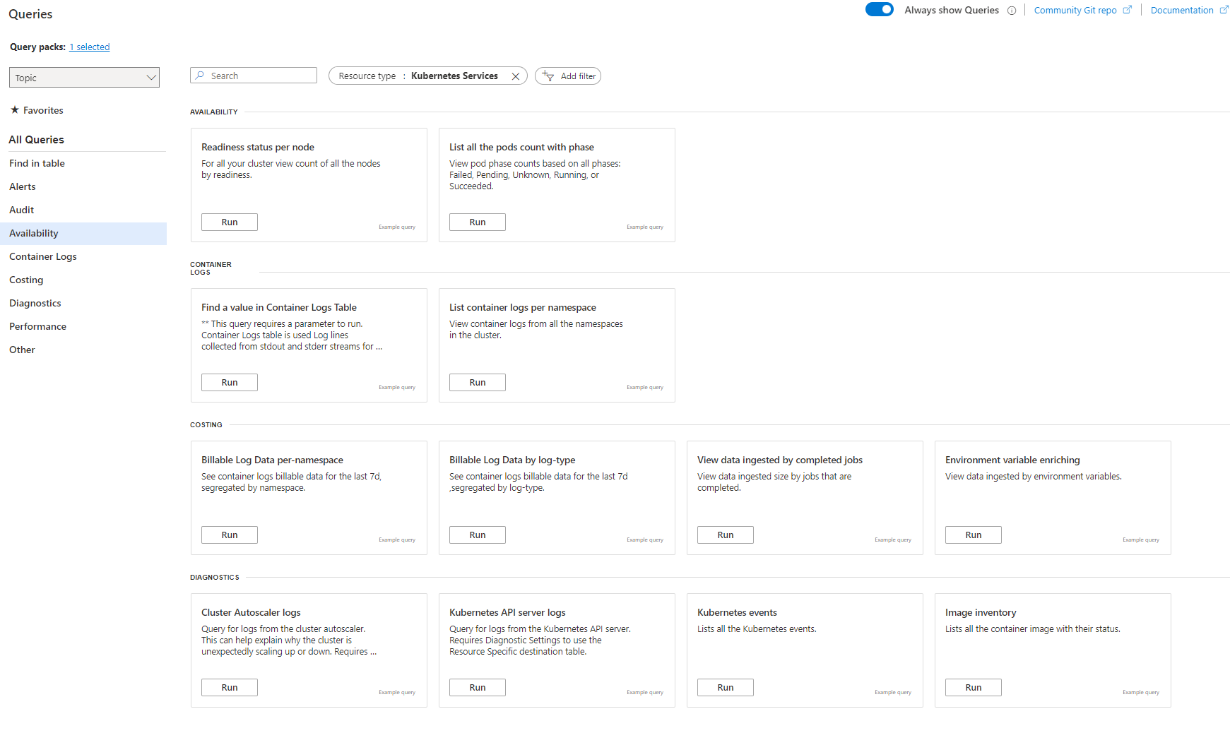
Log Analytics
Notes:
Use built-in queries to query logs and metrics collected in the Log Analytics workspace. The following list describes the functions of some of the queries in the availability, container logs, and diagnostics categories.
Availability
Readiness status per node query: View the count of all nodes in the cluster by the readiness status.
List all the pods count with phase query: View the count of all pods by the phase, such as failed, pending, unknown, running, or succeeded.
Container logs
Find a value in Container Logs Table query: Find rows in the ContainerLogs table where LogEntry has a specified string parameter.
List container logs per namespace query: View container logs from the namespaces in the cluster.
Diagnostics
Cluster Autoscaler logs query: Query for logs from the cluster autoscaler. This query can provide information about why the cluster unexpectedly scales up or down.
Kubernetes API server logs query: Query for logs from the Kubernetes API server.
Image inventory query: List all container images and their status.
Prometheus disk read per second per node query: View Prometheus disk read metrics from the default Kubernetes namespace as a timechart.
Instances Avg CPU usage growth from last week query: Show the average CPU growth by instance in the past week, in descending order.

Slide 41
Examine node and pod health
Notes:
This architecture isn't focused on a workload, rather it concentrates on the AKS cluster itself. The information here is the minimum recommended baseline for most AKS clusters. It integrates with Azure services that deliver observability, a network topology that supports multi-regional growth, and secures the in-cluster traffic.
The target architecture is influenced by your business requirements, and as a result it can vary between different application contexts. It should be considered as your starting point for pre-production and production stages.

Slide 42
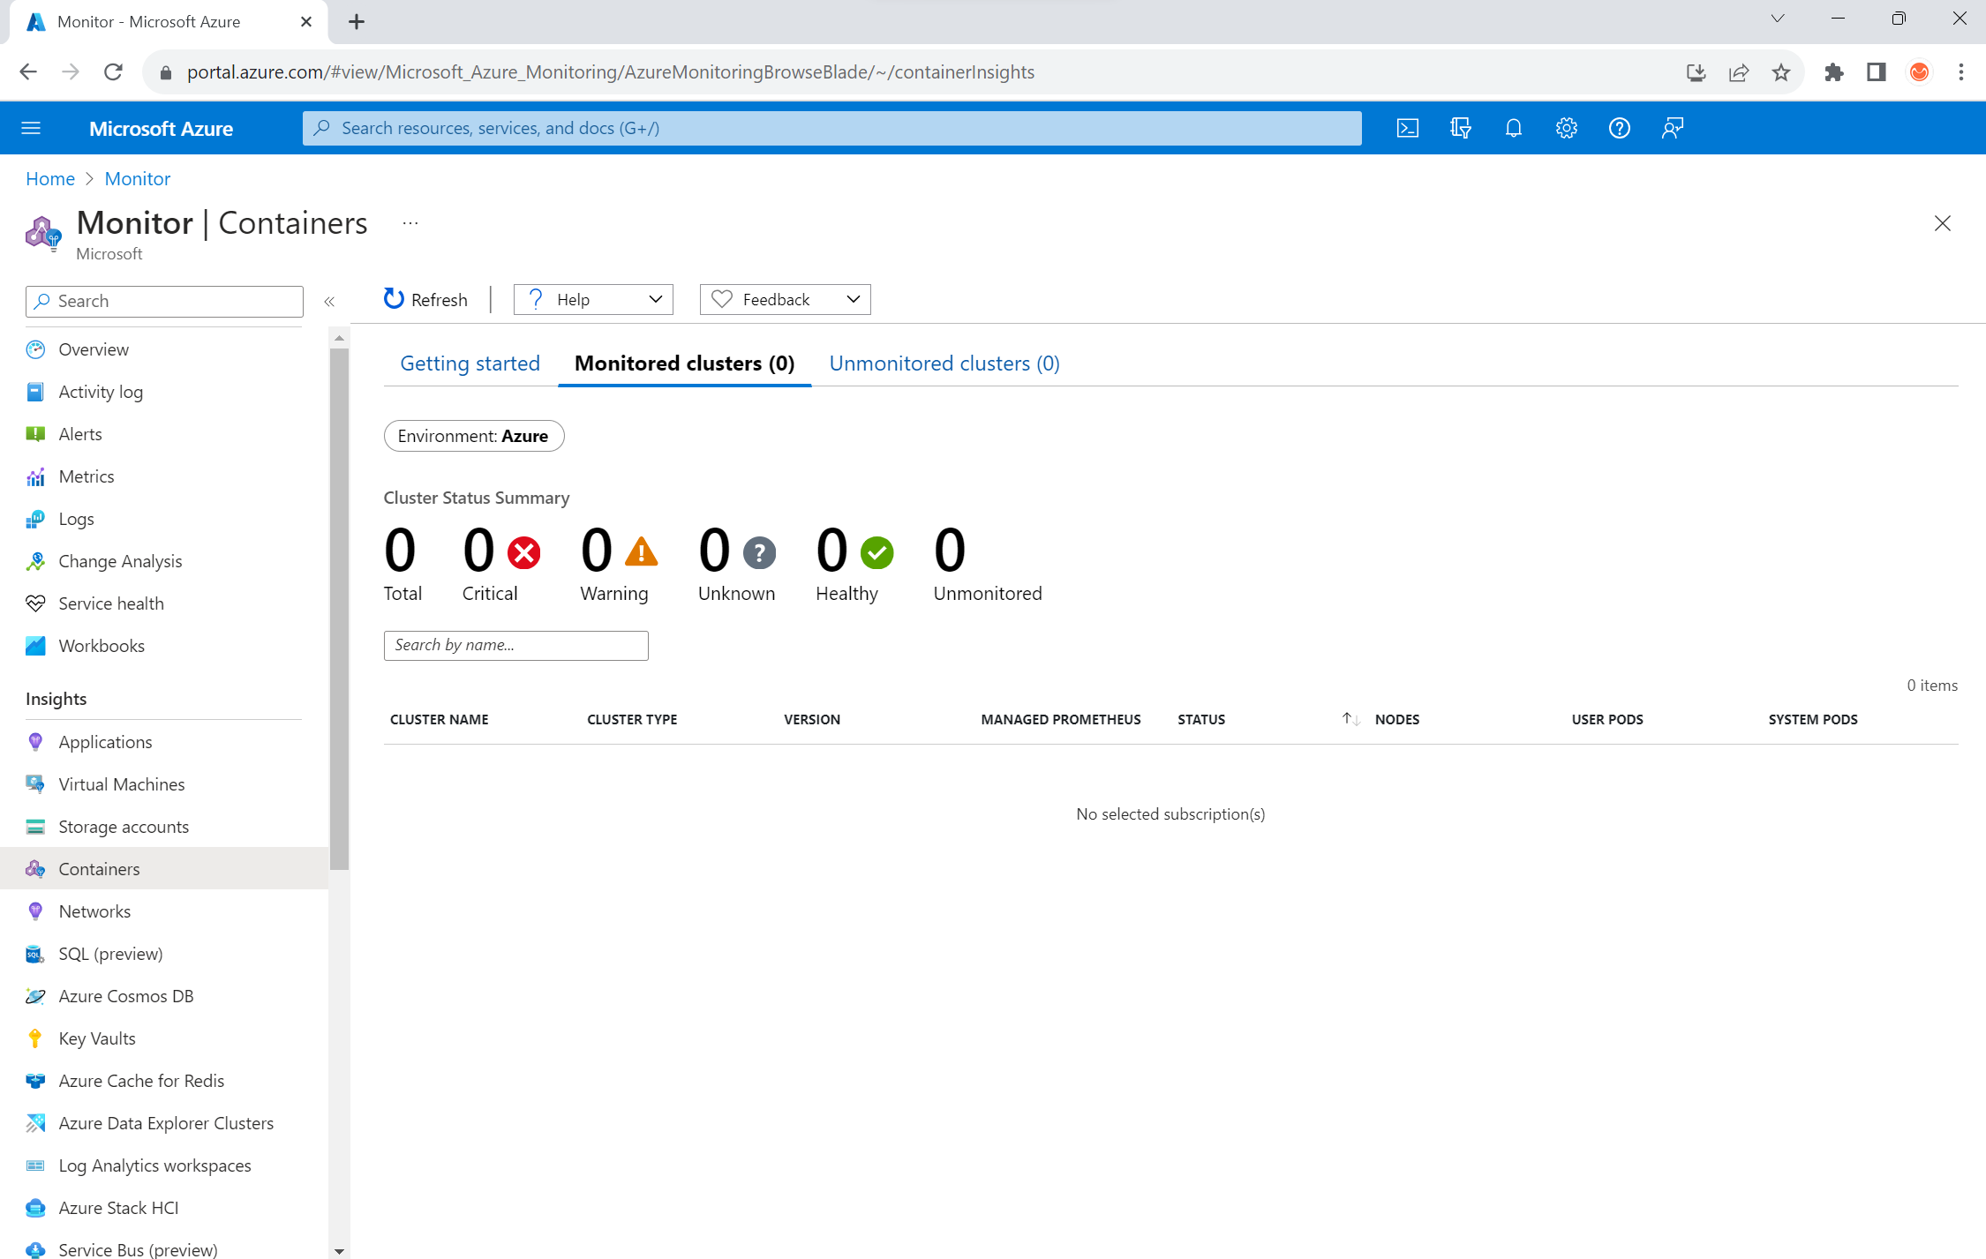
Azure Monitor containers health view
Notes:
To view the health of nodes, user pods, and system pods in your AKS cluster, follow these steps:
In the Azure portal, go to Azure Monitor.
In the Insights section of the navigation pane, select Containers.
Select Monitored clusters for a list of the AKS clusters that are being monitored.
Choose an AKS cluster from the list to view the health of the nodes, user pods, and system pods.

Slide 43
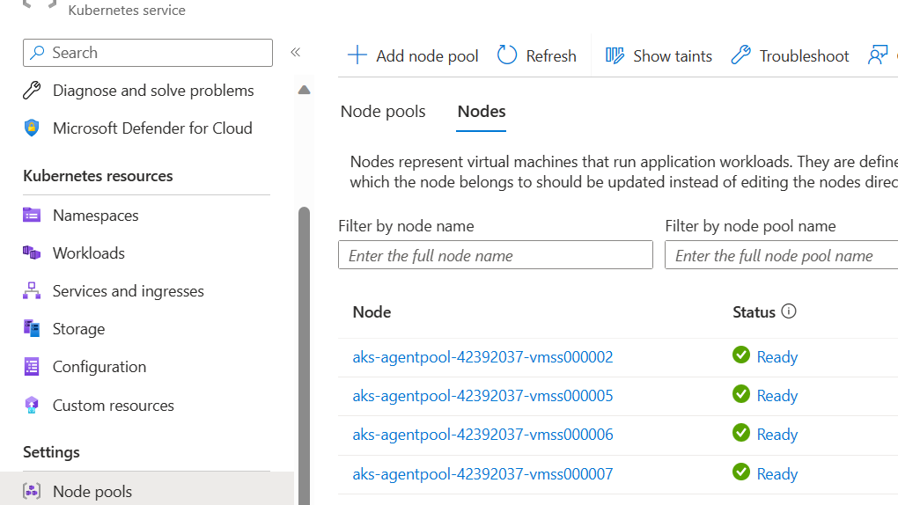
AKS nodes view

Slide 44
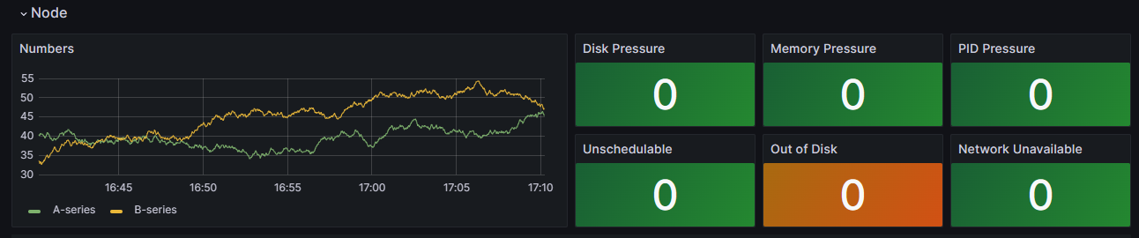
In-cluster monitoring with Prometheus and Grafana
Notes:
Monitor managed service for Prometheus and Azure Managed Grafana
You can use prebuilt dashboards to visualize and analyze Prometheus metrics. To do so, you must set up your AKS cluster to collect Prometheus metrics in Monitor managed service for Prometheus, and connect your Monitor workspace to an Azure Managed Grafana workspace. These dashboards provide a comprehensive view of your Kubernetes cluster's performance and health.
The dashboards are provisioned in the specified Azure Managed Grafana instance in the Managed Prometheus folder. Some dashboards include:
Kubernetes / Compute Resources / Cluster
Kubernetes / Compute Resources / Namespace (Pods)
Kubernetes / Compute Resources / Node (Pods)
Kubernetes / Compute Resources / Pod
Kubernetes / Compute Resources / Namespace (Workloads)
Kubernetes / Compute Resources / Workload
Kubernetes / Kubelet
Node Exporter / USE Method / Node
Node Exporter / Nodes
Kubernetes / Compute Resources / Cluster (Windows)
Kubernetes / Compute Resources / Namespace (Windows)
Kubernetes / Compute Resources / Pod (Windows)
Kubernetes / USE Method / Cluster (Windows)
Kubernetes / USE Method / Node (Windows)

Slide 45
Log Analytics
Notes:
Use built-in queries to query logs and metrics collected in the Log Analytics workspace. The following list describes the functions of some of the queries in the availability, container logs, and diagnostics categories.
Availability
Readiness status per node query: View the count of all nodes in the cluster by the readiness status.
List all the pods count with phase query: View the count of all pods by the phase, such as failed, pending, unknown, running, or succeeded.
Container logs
Find a value in Container Logs Table query: Find rows in the ContainerLogs table where LogEntry has a specified string parameter.
List container logs per namespace query: View container logs from the namespaces in the cluster.
Diagnostics
Cluster Autoscaler logs query: Query for logs from the cluster autoscaler. This query can provide information about why the cluster unexpectedly scales up or down.
Kubernetes API server logs query: Query for logs from the Kubernetes API server.
Image inventory query: List all container images and their status.
Prometheus disk read per second per node query: View Prometheus disk read metrics from the default Kubernetes namespace as a timechart.
Instances Avg CPU usage growth from last week query: Show the average CPU growth by instance in the past week, in descending order.

Slide 46
Verify the control plane and worker node connectivity
To ensure that the connectivity agent pods work properly, run the following command:
kubectl get deploy konnectivity-agent -n kube-system
Make sure that the pods are in a ready state.
view the logs of the konnectivity-agent pods:
kubectl logs -l app=konnectivity-agent -n kube-system --tail=50

Slide 47
End of presentation

